Slide 1




INTEL PRODUCTS SENTIMENT AND TREND ANALYSIS
Machine Learning and Natural Language processing NLP solution
Presented By:
Anan Ahmed
Ahmed Hesham
Kareem Khaled
Noureen Amer
Zainab Galal

Slide 2
AGENDA
Overview
Data Gathering and preprocessing
EDA
Machine Learning
NLP
MLflow
GANs
Deployment
Contribution

Slide 3

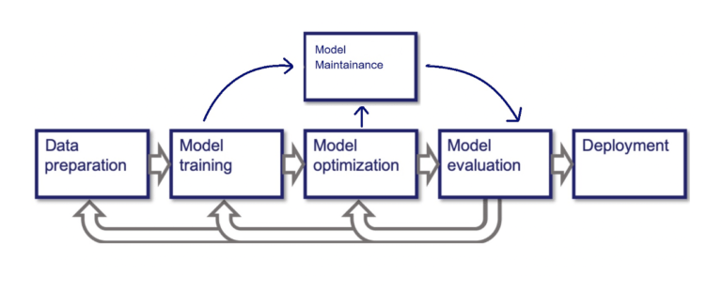

OVERVIEW
Intel Review Analyzer is a powerful tool designed to help businesses understand customer sentiments through automated analysis of reviews.
This project leverages state-of-the-art NLP techniques to classify reviews, highlight key sentiments, generate word clouds, and visualize trends over time. It works for both amazon and flipkart.
Key technologies:
Python (Pandas, SpaCy) for EDA and preprocessing.
Machine Learning (Naive bayes, SVM and Random Forest).
NLP (VADER, RoBERTa and BERT)
Azure AI for deployment and scaling.

Slide 4
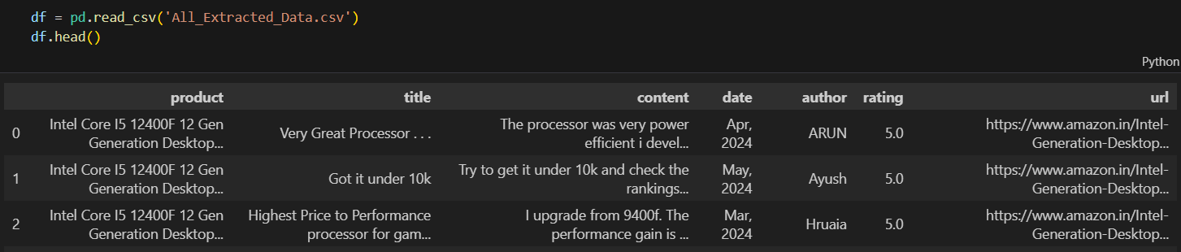
DATA COLLECTION AND PREPROCESSING
Data Gathering:
Collected customer feedback from Amazon on intel CPU products.
These reviews include information like (Product name, rating, feedback title, feedback content and feedback date)
Each feedback has a URL referring to its reference from where it was extracted.

Slide 5




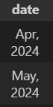
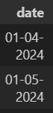
Data pre-processing steps
Text Cleaning: Clean the title and content columns to remove noise, unwanted characters, and normalize the text for analysis.
Lowercasing: Converted all text to lowercase for uniformity.
Removing Punctuation: Removed punctuation to focus only on words.
Removing Unicode Characters: Cleaned up any non-standard characters (e.g., \xa0, \x8c).
Removing Non-ASCII Characters: Stripped out any characters outside the ASCII range to ensure compatibility.
Removing Extra Spaces: Normalized spacing to ensure consistency.
2. Date Formatting: Ensure consistency in date formats across the dataset
Converted dates to a consistent format (DD-MM-YYYY).
Filled any missing dates with the mean date value of the dataset.

Slide 6
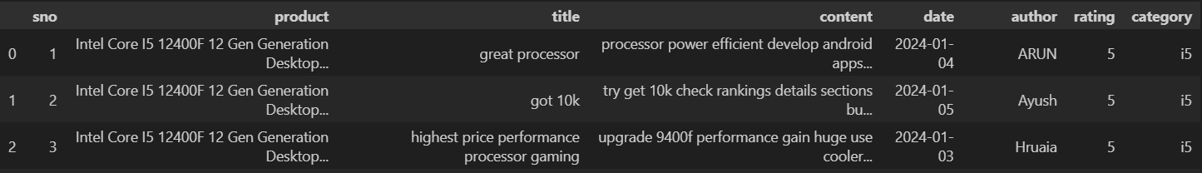
3. Product Categorization: Categorize the products into Intel’s processor models (i3, i5, i7, i9) based on the product name.
4. Rating Cleaning: Clean the rating column by extracting numeric values and ensuring consistency in the rating format.
Extracted digits from the rating string and converted them to integers.
Rounded float values to zero decimal points for clarity.
5. Removing Stop Words: Reduce noise in the text data by removing common stop words (like "the," "is," "in") that don't contribute to the sentiment or meaning.
Used NLTK’s English stop words list to filter out unnecessary words from both title and content columns.
Clean DATA after pre-processing

Slide 7
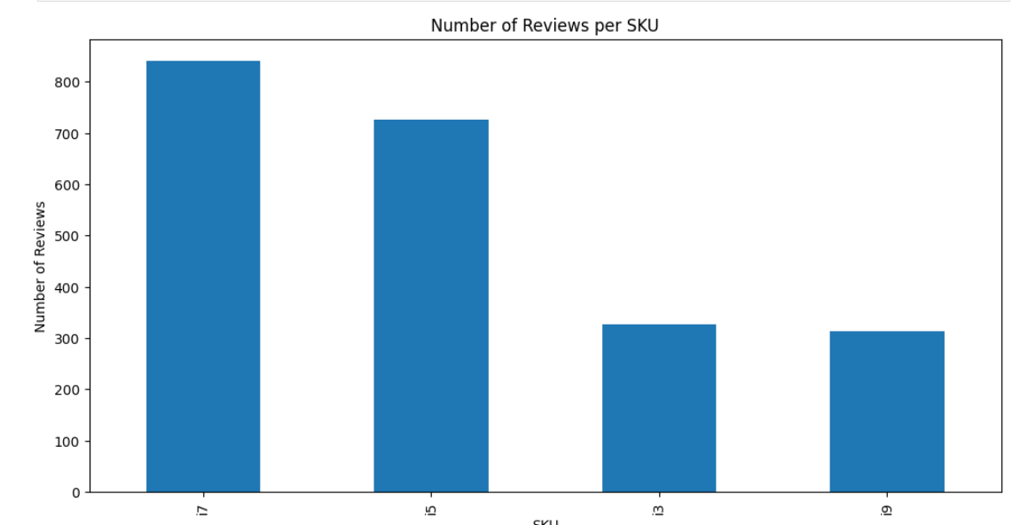
EDA EXPLORATORY DATA ANALYSIS
The following graphs gives us a brief overview on our data:
No of reviews pre product
distribution of ratings
It helps deepen our view on the data; so we can think of a suitable Learning model.

Slide 8
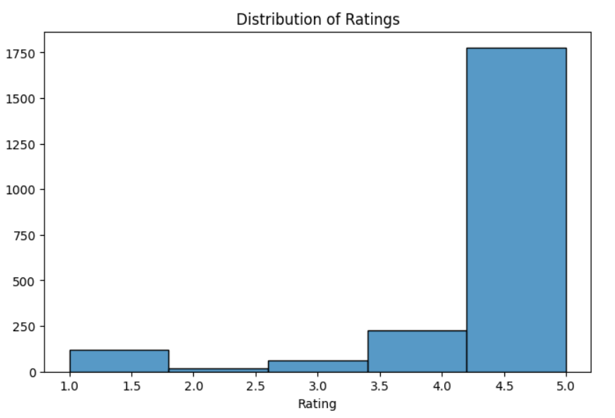

Slide 9
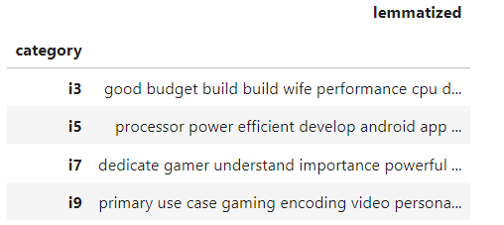
Text analysis
To achieve the polarity analysis of the text reviews data, we have to do some text pre-processing first using the SpaCy NLP model to perform lemmatization (converting words to their base forms) and stopwords removal (removing common words like "the", "and", etc.) on the product reviews.
Each processed review undergoes sentiment analysis using TextBlob, which calculates a polarity score ranging from -1 (negative) to 1 (positive).
The average sentiment polarity is computed for each product category.

Slide 10
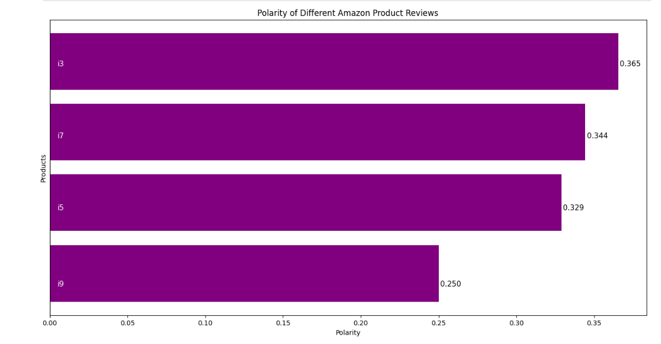
The next graph represents the average sentiment polarity for different product categories.
It also includes labels for product categories and their respective polarity scores.

Slide 11
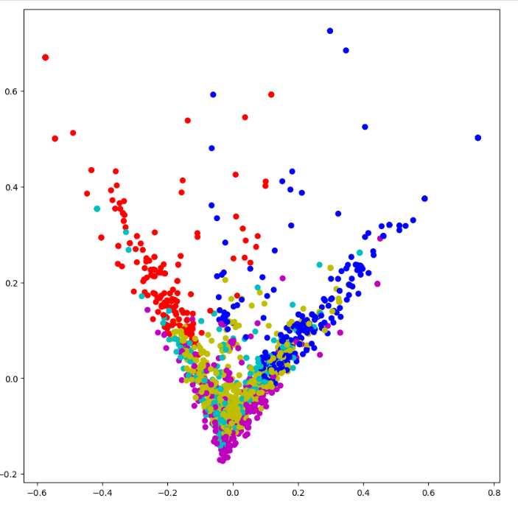
Clustering of Product Reviews Using K-Means and PCA Visualization
TF-IDF Vectorization:
using TfidfVectorizer to transform the text data (in this case, reviews in the content column) into a TF-IDF matrix. This matrix represents the importance of words in the document set, while removing common stopwords (like "and", "the", etc.).
K-Means Clustering:
K-Means is applied to group the reviews into 5 clusters based on the similarity of their content. The cluster labels are then added to the DataFrame as a new column called Cluster.
PCA for Dimensionality Reduction:
Since TF-IDF creates high-dimensional data, PCA (Principal Component Analysis) is used to reduce the dimensionality of the data to 2 components, making it easier to visualize.

Slide 12

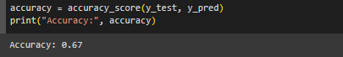
Machine learning approach
Naive Bayes Model:
Introduction to Naive Bayes:
Naive Bayes is a probabilistic classifier based on applying Bayes' Theorem. It assumes that features (words in our case) are independent of each other.
Why Naive Bayes?:
Naive Bayes is commonly used in text classification due to its simplicity and speed, making it a good starting point for sentiment analysis.
Training and Testing:
We trained the Naive Bayes model using 80% of the dataset and tested it on the remaining 20%. The text was converted to numerical features using TF-IDF (Term Frequency-Inverse Document Frequency).
Model Accuracy:
The model achieved an accuracy of 67%."
"While this is a moderate result, it's not ideal for a sentiment analysis task where precision in understanding context and emotions is crucial.

Slide 13
Limitations of Naive Bayes for Sentiment Analysis:
Assumption of Independence:
Naive Bayes assumes that all features (words) are independent of each other. In sentiment analysis, this assumption is problematic because word combinations and context often carry significant meaning. For example, 'not bad' expresses a positive sentiment, but Naive Bayes may treat 'not' and 'bad' separately.
Weakness in Handling Complex Language:
Naive Bayes struggles with understanding complex language features like negation, sarcasm, and tone. Sentiment is often subtle, and words like 'great' or 'horrible' can shift the overall meaning when used with other words.
Over-Reliance on Frequency:
Naive Bayes tends to favor words that frequently appear in a particular class (positive, neutral, or negative). This can result in the model being biased toward frequent terms and overlooking rarer but more impactful words.

Slide 14

SVM Model:
SVM:
Support Vector Machine (SVM) is a powerful classification algorithm that finds the best boundary (called a hyperplane) to separate different classes of data. It maximizes the margin between data points from different classes, ensuring better generalization on unseen data.
Why SVM?:
We used Support Vector Machines (SVM) because SVM is highly effective for text classification tasks, particularly when dealing with high-dimensional data, like text. It helps find a hyperplane that best separates the sentiment classes.
Objective:
The objective of the model is to accurately predict the sentiment of a given review based on its textual content.

Slide 15
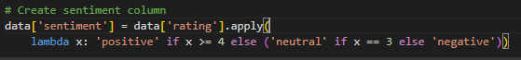
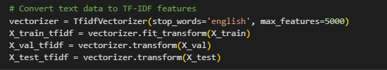
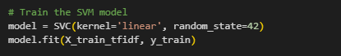
Data Preprocessing and Feature Engineering:
Sentiment Labels:
We converted the numerical ratings into three sentiment classes:
Positive: Ratings of 4 or higher
Neutral: Rating of 3
Negative: Ratings of 2 or lower
TF-IDF Vectorization:
The review text was transformed into numerical features using the Term Frequency-Inverse Document Frequency (TF-IDF) method. TF-IDF measures how important a word is to a document in the corpus, helping to capture the most meaningful words from the text.
Model Training:
The SVM model was trained using the reviews transformed into TF-IDF vectors. The input data consists of numerical representations of the text, while the target data are the sentiment labels (positive, neutral, negative).

Slide 16
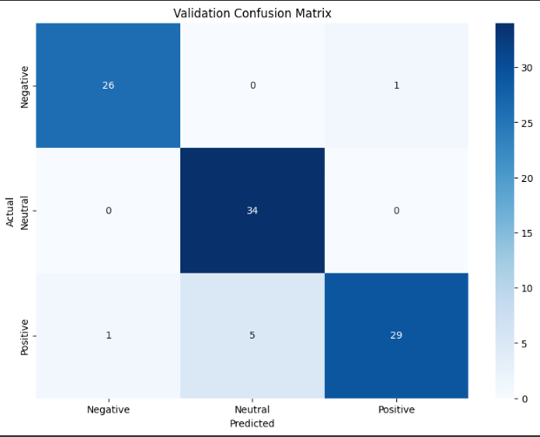
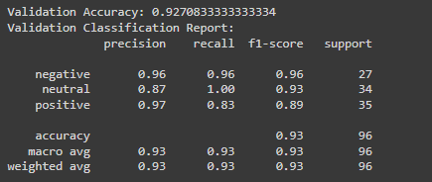
Evaluation Metrics:
We evaluated the model's performance using various classification metrics:
Accuracy: Measures the overall correctness of the model and it scored 0.92708
Precision, Recall, and F1-score: Provide insights into the model’s ability to correctly classify each sentiment class (positive, neutral, and negative).
Confusion Matrix:
Here is a confusion matrix showing the performance of the SVM model. The diagonal elements represent correct predictions for each class, while the off-diagonal elements represent misclassifications.

Slide 17
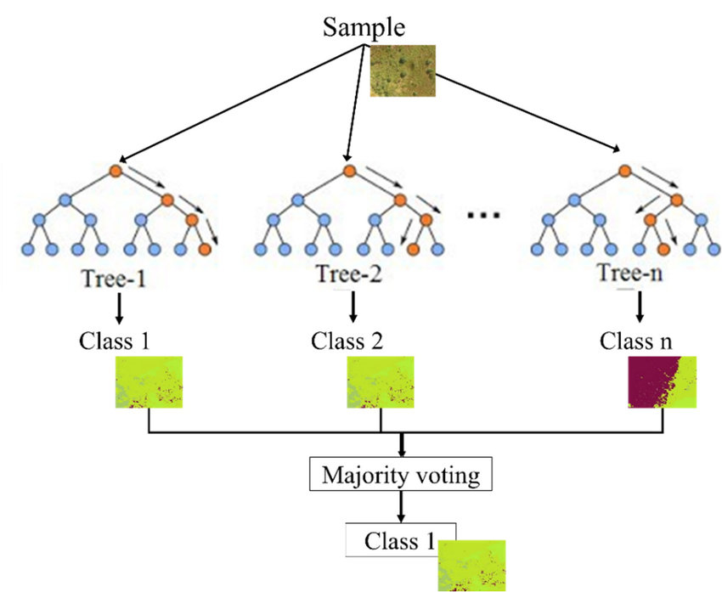
Random Forest Classifier:
Introduction to Random Forest:
Random Forest is an ensemble learning method that uses multiple decision trees to make a prediction. The final prediction is based on the majority vote of individual trees, which helps improve accuracy and reduce overfitting
Why Random Forest?:
We chose Random Forest because it handles both structured and unstructured data, is robust against overfitting, and performs well with large feature spaces like text data.

Slide 18
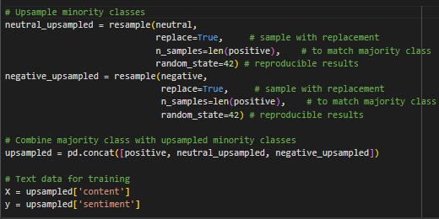
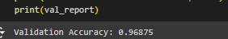
Model Training and Validation Results:
Upsampling:
Since the dataset was imbalanced, we used upsampling to ensure the minority classes (neutral and negative) were well-represented.
Training the Random Forest:
The Random Forest classifier was trained with 100 decision trees. Validation was performed on a separate set of data to evaluate the model's generalization capability.
Validation Accuracy:
The validation accuracy was 96.88%, which demonstrates strong performance on the unseen validation set."

Slide 19
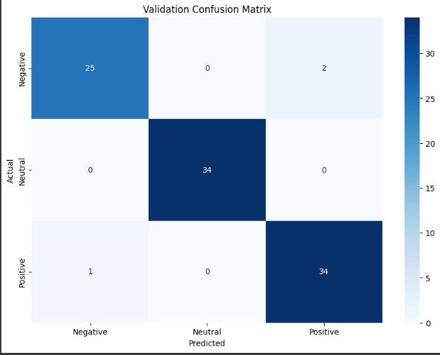
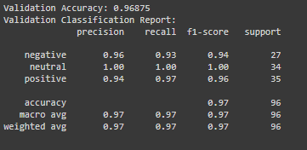
Classification Report:
For the validation data, the model showed high precision and recall across all sentiment classes (positive, neutral, negative). The f1-score was 0.97, indicating balanced performance in identifying all classes.
Confusion Matrix:
The confusion matrix below shows that the model made few mistakes during validation. Most misclassifications occurred between 'negative' and 'positive' sentiment, which is expected due to the nuances of human emotion in text.

Slide 20
Comparison between the three models:
Model | Naïve-Bayes | Support Vector Machine (SVM) | Random Forest (RF)
Algorithm Type | Probabilistic Classifier | Linear Classifier | Ensemble Learning (Decision Trees)
Assumption | Assumes independence between features (words) | Maximizes margin between classes (hyperplane) | Aggregates multiple decision trees
Handling of Text Data | Fast for text classification, uses word frequencies | Handles high-dimensional data well, good for text classification | Can handle large feature sets and imbalanced data
Accuracy | 67% (Moderate) | 94.79% (High) | 96.88% (Very High)
Strengths | Simple, computationally efficient | Good for complex and high-dimensional data | Robust, less prone to overfitting
Weaknesses | Struggles with context, complex language (e.g., sarcasm, negation) | May require more tuning, computationally expensive | More complex, slower than Naive Bayes
Use Case Suitability | Suitable for initial, lightweight text classification tasks | Better for text with complex language patterns | Ideal for handling complex and imbalanced text data

Slide 21
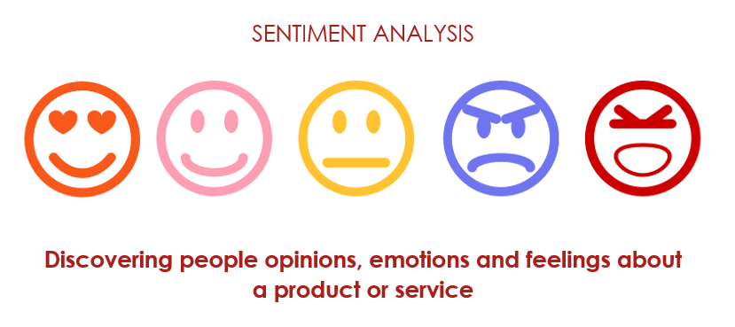

NLP approach
Why NLP?
Natural Language Processing (NLP) techniques, especially those involving attention-based models like BERT and RoBERTa, are highly effective for sentiment analysis because they can understand the context and nuances of human language better than traditional machine learning models. NLP models excel at capturing the meaning of words in context, handling complex sentence structures, and understanding subtle emotions. This makes NLP especially valuable for sentiment analysis,

Slide 22
Traditional Machine Learning Models | NLP Models
Feature Extraction: Machine learning models like Logistic Regression and Random Forest require manual feature extraction, such as TF-IDF or bag-of-words, to convert text into numerical data. Efficiency: They are generally faster to train but require more preprocessing and feature engineering. Performance: These models can perform well on structured, smaller datasets but struggle with understanding context and subtleties in language, such as sarcasm, word order, or negations. | Contextual Understanding: NLP models use attention mechanisms to understand the meaning of words in relation to each other within a sentence, allowing them to grasp context and nuance far better than traditional models. Pre-trained Models: Leveraging large pre-trained models, NLP techniques can apply deep contextual knowledge and language understanding to perform well even on complex or unseen data. Performance: NLP models generally outperform machine learning models in accuracy and can handle intricate language patterns, although they are more computationally intensive.

Slide 23
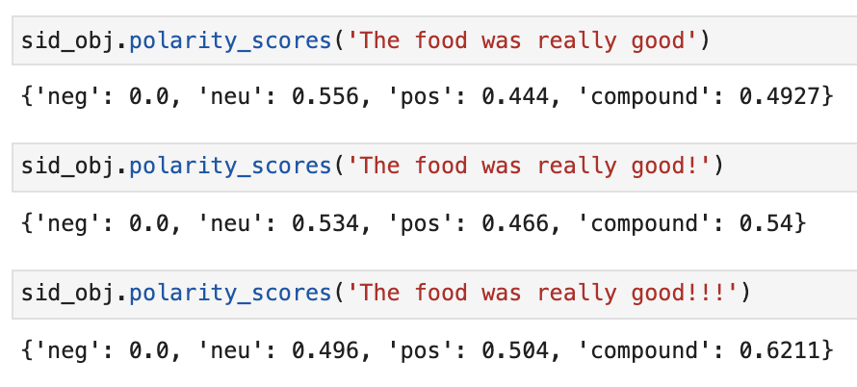
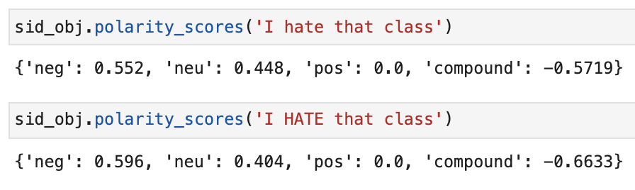
VADER
Lexicon-based sentiment analysis
Analyzes the sentiment of product reviews using polarity scores to classify reviews into positive, neutral, and negative categories.
VADER captures the effects of punctuation
A similar effect with ALL CAPS

Slide 24
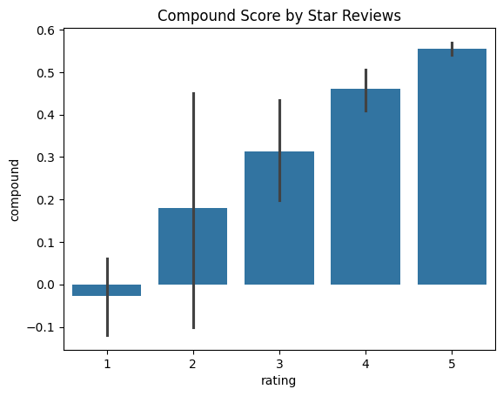
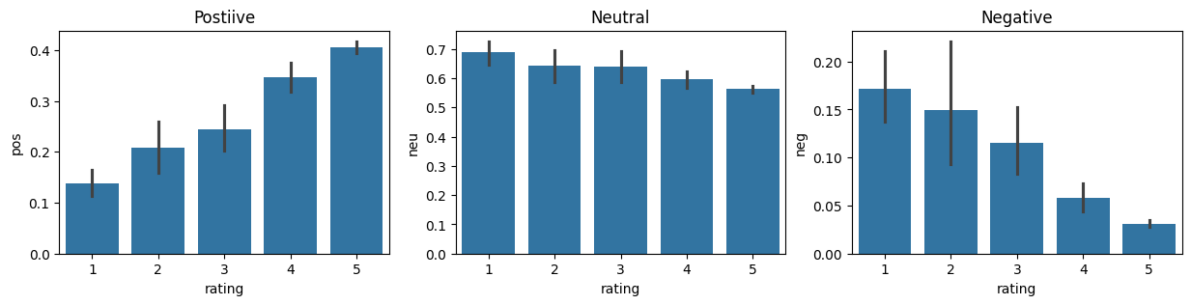
Applying VADER to the Dataset
- The VADER model is run on the entire dataset of product reviews, generating sentiment scores for each review.
This set of plots shows how positive, neutral, and negative scores vary with different review ratings (1-star to 5-star).

Slide 25
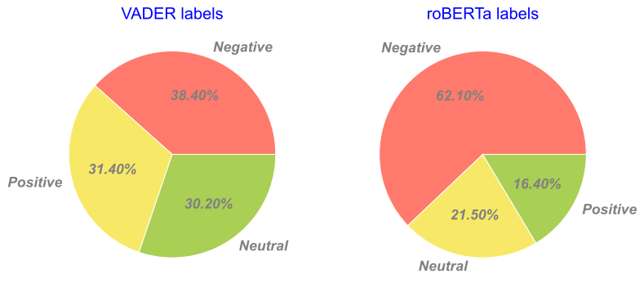
VADER vs. RoBERTa
RoBERTa (Robustly Optimized BERT) is Pre-trained transformer model fine-tuned for sentiment analysis.
It Offers better contextual understanding and higher accuracy on social media text.
Example of how VADER and RoBERTa may differ
VADER: Performs well on simple sentiment analysis but may struggle with nuanced text.
RoBERTa: More sophisticated, with improved handling of subtle sentiment in context, but it requires more computational resources.

Slide 26
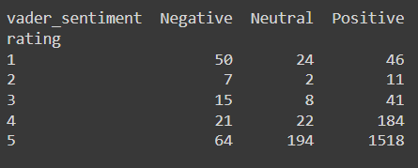
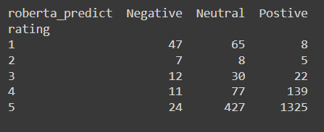
Implementing RoBERTa
Model Used: cardiffnlp/twitter-roberta-base-sentiment, a pre-trained RoBERTa model fine-tuned on Twitter sentiment data.
RoBERTa outputs scores for positive, neutral, and negative sentiments.
For each review, RoBERTa and VADER scores are calculated, and the results are merged into a single dataset.
Result: A dataframe (results_df) is created that combines VADER and RoBERTa sentiment scores with the original review data.
VADER | RoBERTa
Uses the compound score to classify reviews as positive, neutral, or negative. | Compares the probabilities of positive, neutral, and negative sentiment to predict the label.
Pivot Table: Shows how many reviews are classified into each sentiment category
This comparison helps to see how well the models align with human ratings.

Slide 27
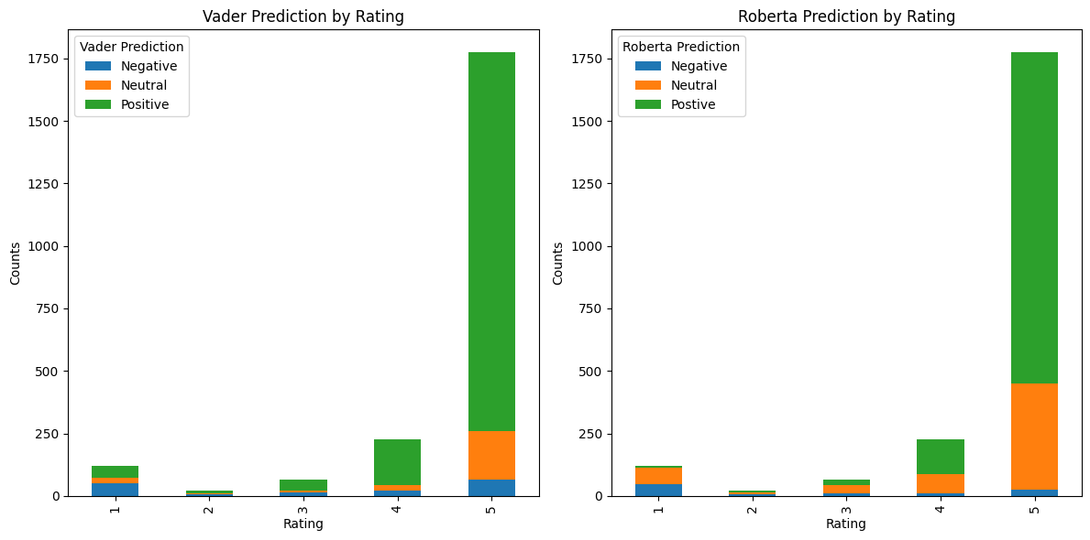
Overall Performance: The analysis shows that RoBERTa provides more accurate predictions when dealing with nuanced language, while VADER is faster and works well for straightforward sentiment analysis.

Slide 28
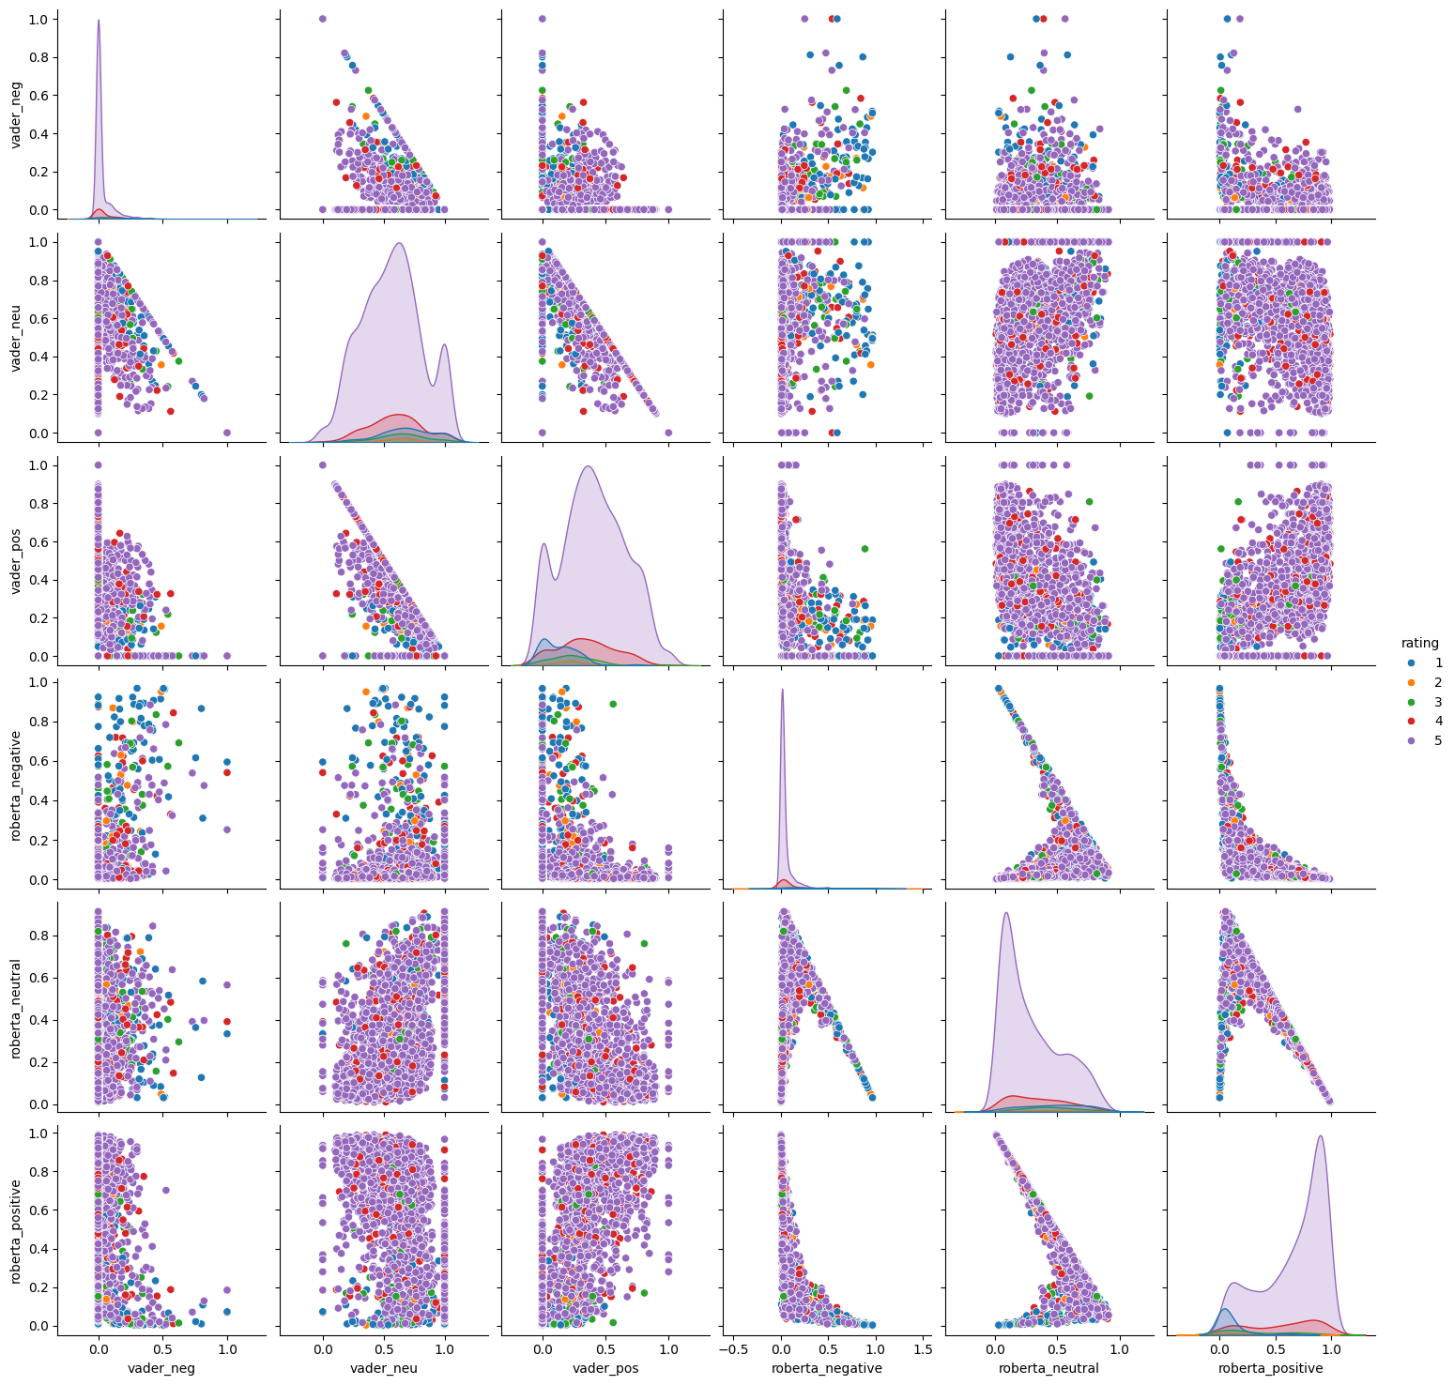
This plot helps reveal correlations and differences in how VADER and RoBERTa interpret sentiment within the same reviews.

Slide 29

BERT
Deep learning transformer model for sequence classification.
BERT's Key Features:
Trained on large corpora for understanding context.
Can distinguish fine nuances in text (e.g., sarcasm, irony).
Supports multi-class classification (Positive, Neutral, Negative).
Model Used: bert-base-uncased, a pre-trained BERT model fine-tuned for sequence classification.

Slide 30
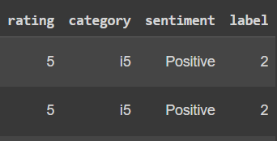
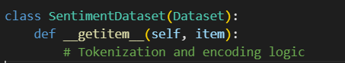
Dataset Preparation
Rating Categorization: Star ratings are mapped into three sentiment categories—Positive (4-5), Neutral (3), and Negative (1-2).
Label Encoding: The sentiment labels (Positive, Neutral, Negative) are converted into numerical format using label encoding for model training.
- Custom Dataset Class: A PyTorch Dataset is created to handle tokenization and label encoding for each review.
- The BERT tokenizer processes each review, ensuring the input fits within BERT’s required format (token IDs, attention masks).

Slide 31
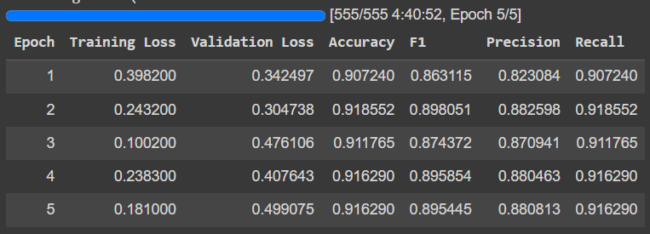
BERT MODEL AND TRAINING CONFIGURATION
Model Used: BertForSequenceClassification, which is fine-tuned for sentiment analysis with 3 output labels (Positive, Neutral, Negative).
Batch size: 16
Epochs: 5
Warmup steps: 500 (gradual learning rate increase)

Slide 32
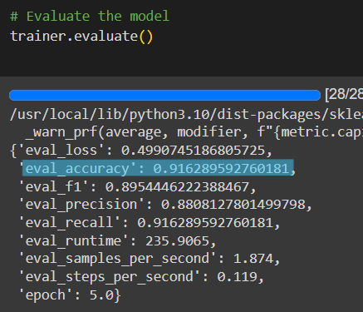
BERT MODEL EVALUATION
Evaluation Results: After training, the model achieved an accuracy score of 0.916

Slide 33
GANs
we implemented a Generative Adversarial Network (GAN) to generate text sequences related to customer sentiment for Intel products.
The GAN consists of two models: the Generator and the Discriminator. This architecture is designed to create realistic customer feedback based on sentiment data.
Generator: Learns to generate realistic customer reviews related to Intel products by creating sequences that reflect different customer sentiments (positive, neutral, or negative). The Generator mimics real reviews using LSTMs and word embeddings.
Discriminator: Evaluates and classifies customer reviews as real or generated, helping to improve the quality of the Generator's output by pushing it to generate more authentic text.
This GAN-based approach aims to simulate customer sentiment patterns, which can be valuable for sentiment analysis tasks such as feedback generation, market trend prediction, and sentiment classification of customer reviews for Intel products.

Slide 34
1. Generator Model
The Generator is responsible for creating synthetic customer reviews based on random noise, which represents the initial input.
Input: Random noise vector (noise_dim), used to generate realistic customer feedback.
Architecture:
Fully Connected Layer (fc1): Maps the noise into a sequence of embeddings. The output is reshaped into (batch_size, seq_len, embedding_dim) to match the desired format of customer reviews.
LSTM Layer: This Long Short-Term Memory (LSTM) layer captures temporal dependencies, ensuring that the generated review text follows a coherent sequence.
Output Layer (fc2): Converts the LSTM output into logits representing word probabilities across the vocabulary, generating words based on learned patterns of real customer reviews.
Output: A sequence of words or word probabilities resembling customer sentiment.
2. Discriminator Model
The Discriminator is a binary classifier that evaluates whether a given sequence (customer review) is real (from actual data) or fake (generated by the Generator).
Input: A sequence of customer sentiment text, either generated by the Generator or from real customer feedback.
Architecture:
Flattening: The input sequence is flattened to fit into fully connected layers.
Fully Connected Layers (fc):
512 neurons, activated using LeakyReLU, helping to learn complex patterns.
256 neurons, with LeakyReLU for deeper learning.
Final Layer: Outputs a single value (0 for fake or 1 for real) using a Sigmoid activation function, which classifies the review as either genuine or generated.
Output: A probability score where 1 indicates a real customer review and 0 indicates a generated (fake) one.

Slide 35

MLFLOW
Used MLflow to Track Model Training.
- MLflow UI provides an easy way to track experiments and compare multiple runs.
- Each Run in MLflow captures:
Model parameters
Performance metrics like accuracy, precision, recall, and F1-score
Loss value for evaluation

Slide 36
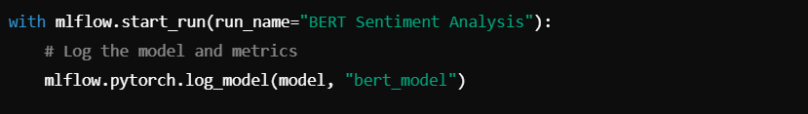
MLflow integration
Setting up an Experiment:
2.Tracking a Model Training Run:
3. Opening the MLflow Page for Results Demonstration
Key Observation:
The BERT model achieved 91.4% accuracy, which indicates strong performance for sentiment classification.
Conclusion
MLflow played a crucial role in managing the training process:
Reproducibility: Any run can be re-executed with the same parameters.
Comparison: Easily identify the best model based on metrics.
Versioning: All model artifacts are stored, making it easier to deploy or improve in the future.

Slide 37
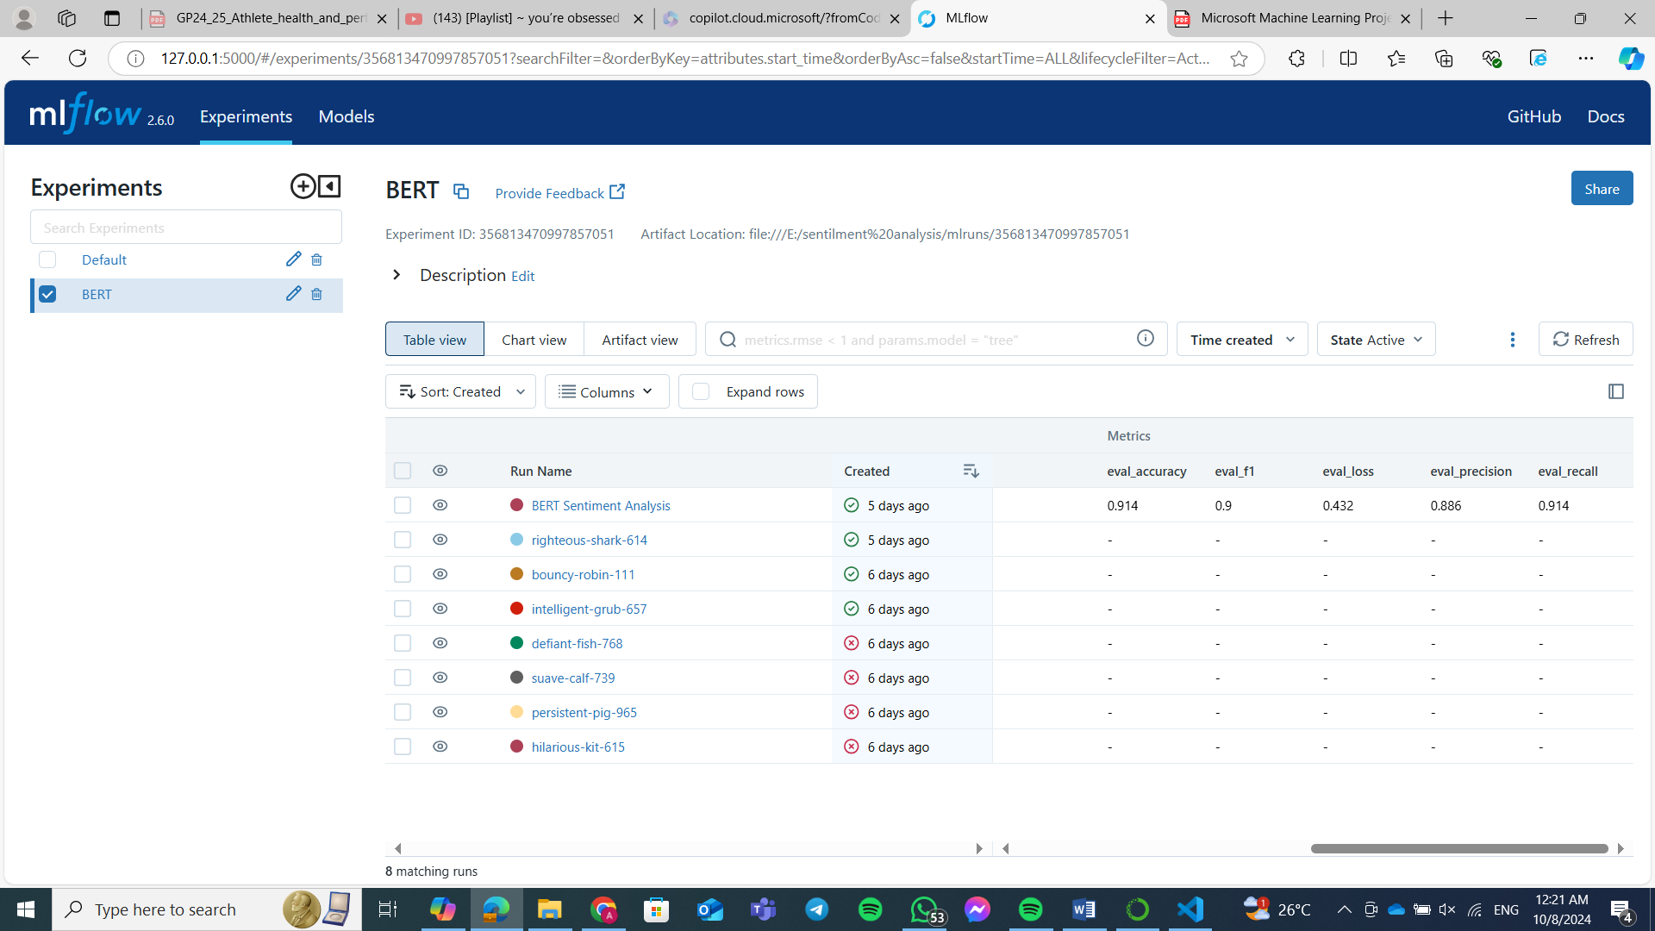

Slide 38
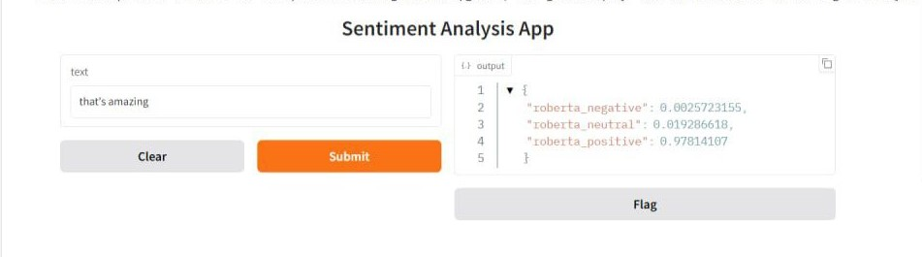
Sentiment Analysis Model Deployment
with Gradio
Deployed Twitter RoBERTa sentiment analysis model using Gradio for quick and interactive web-based access.
Benefits of Gradio:
Fast and easy deployment for demos and prototyping.
Interactive interface allows real-time model testing.
No complex backend or web framework needed.

Slide 39
CONTRIBUTION
All team members contributed throughout the whole project, we discussed a lot of points all over the project together. But we can divide the project to 6 main tasks:
Task | Contributor
Data Gathering and pre-processing | Ahmed Hesham
Machine Learning | Kareem Khaled
NLP (VADER vs RoBERTa) | Noureen Amer
BERT and MLflow integration | Anan Ahmed
GANs and Model deployment | Zainab Galal
documentation | All team

Slide 40
THANK YOU FOR LISTENING!

